Slide 1

CS 4593/6463 – Bitcoins and Cryptocurrencies
Prof. Murtuza Jadliwala
murtuza.jadliwala@utsa.edu
Note: most of the slides used in this course are derived from those available for the book “Bitcoins and Cryptocurrencies Technologies – A Comprehensive Introduction”, Arvind Narayanan, Joseph Bonneau, Edward Felten, Andrew Miller & Steven Goldfeder, 2016, Princeton University Press.

Slide 2
Lecture 2
How Bitcoin Achieves Decentralization

Slide 3
Centralization vs. decentralization

Slide 4
Centralization vs. decentralization
Competing paradigms that underlie many digital technologies
Centralized: Online Social Networking Services (Facebook, Google)
Decentralized: Internet, Email service and the SMTP protocol
Decentralization is not all-or-nothing: For example, E-mail. Email has a decentralized protocol (e.g., SMTP), but dominated by centralized webmail services

Slide 5
Aspects of decentralization in Bitcoin
Who maintains the ledger?
Who has authority over which transactions are valid?
Who creates new bitcoins?
Who determines how the rules of the system change?
How do bitcoins acquire exchange value?
Beyond the protocol:
Exchanges, Wallet software, Service providers...
Our focus in this chapter

Slide 6
Aspects of decentralization in Bitcoin
Peer-to-peer network:
Open to anyone, Low barrier to entry
Mining:
Open to anyone, but inevitable concentration of power
often seen as undesirable
Updates to software:
Core developers trusted by community, have great power

Slide 7
Distributed consensus

Slide 8
Bitcoin’s key challenge
Key technical challenge of decentralized e-cash: distributed consensus
or: how to decentralize ScroogeCoin

Slide 9
Why consensus protocols?
Traditional motivation: reliability in distributed systems
Distributed key-value store enables various applications: DNS, public key directory, stock trades …

Slide 10
Defining distributed consensus
There are “n” nodes, each have an input value. Some nodes are faulty or malicious. A distributed consensus protocol has the following two properties:
The protocol terminates and all honest nodes are in agreement on the same value
This value must have been proposed by some honest node
What does this mean in the context of Bitcoins?

Slide 11
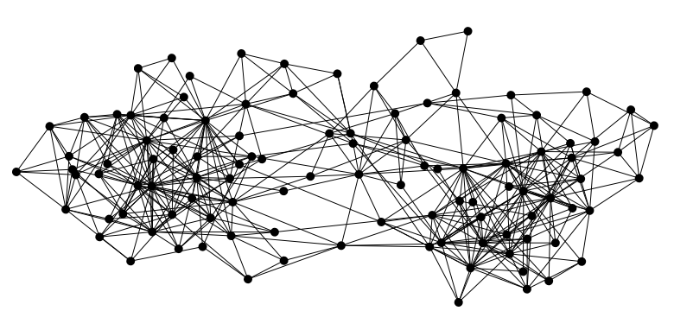

Bitcoin is a peer-to-peer system
When Alice wants to pay Bob: she broadcasts the transaction to all Bitcoin nodes
signed by Alice
Pay to pk_{Bob} : H( )
Note: Bob’s computer may not be in the picture or online!
In fact, running a Bitcoin node is not important for Bob to receive the funds. The Bitcoins will be his regardless

Slide 12
What nodes need to reach a consensus on?
Which transactions were broadcast on the network
Order in which these transactions occurred
→ Result of the consensus protocol: Single, global transaction ledger for the system

Slide 13
How consensus could work in Bitcoin
At any given time (in the bitcoin peer-to-peer network):
All nodes have a sequence of blocks of transactions (called, ledger or block chain) they’ve reached consensus on
Each node has a set of outstanding transactions it’s heard about (but not yet included in the block chain)
For these transactions consensus has not yet happened
Each node may have a slightly different outstanding transaction pool

Slide 14



How consensus could work in Bitcoin
Tx
Tx
…
Tx
Tx
Tx
Tx
Tx
Tx
Tx
…
…
…
Consensus
protocol
Tx
Tx
Tx
Tx
Tx
Tx
Tx
…
…
Tx
Tx
OK to select any valid block, even if proposed by only one node

Slide 15
Why consensus is hard (esp. in the Bitcoin context)?
Nodes may crash
Nodes may be malicious
Peer-to-peer network is imperfect
Not all pairs of nodes connected (and may participate)
Faults in network
Latency
No notion of global time → constraints the set of consensus algorithms that can be used
Notes:
Analogy of talking on the phone and having a lag

Slide 16
Many impossibility results
Byzantine generals problem: Consensus impossible to achieve if 1/3 or more generals are traitors
Fischer-Lynch-Paterson (deterministic nodes): consensus impossible with a single faulty node (under certain conditions)

Slide 17
Some well-known protocols
Example: Paxos
Never produces inconsistent result, but can (rarely) get stuck

Slide 18
Understanding impossibility results
The earlier results proven for specific models
Specifically, distributed databases
A distributed database model (and assumptions under it) doesn’t carry over to Bitcoins!
These results say more about the model than about the problem
What does it mean?
It may be possible to develop consensus protocols that work for Bitcoin networks

Slide 19
Bitcoin consensus: theory & practice
Bitcoin consensus works better in practice than in theory
Theory is still catching up
BUT theory is important, can help predict unforeseen attacks

Slide 20
So why is the problem of consensus different in Bitcoins?
Introduces incentives
Possible only because it’s a currency!
So in Bitcoins we do not have to solve the consensus problem in general, but only the one for a currency system
Embraces randomness
Does away with the notion of a specific starting and ending point for consensus
Consensus happens over long time scales — about 1 hour
In summary, consensus in Bitcoins is not deterministic – Even at the end of 1 hour nodes may not be 100% sure that their view of the block chain is the consensus view
Although the probability of that not being the case is very low

Slide 21
Consensus without identity: using a block chain
Bitcoin’s consensus algorithm

Slide 22
Bitcoin nodes don’t have long-term identities
Why?
Identity is hard in a P2P system — Sybil attack
Pseudonymity is a goal of Bitcoin

Slide 23
Why having identity is useful for consensus?
Answer: It makes the consensus protocol easy to design! But how?
Pragmatic: some protocols need node IDs
Protocols could have instructions of the form “Now node with lowest ID, do something..”
Without identities, instructions are constrained
Security: assume less than 50% malicious
If nodes have identities, and difficult to create new node identities then some assumptions about the number of malicious nodes can be made
This can be used to prove certain security properties

Slide 24
How to overcome lack of identity in Bitcoins?
Weaker assumption: select random node in the bitcoin network
Analogy: lottery or raffle
When tracking & verifying identities is hard, we give people tokens, tickets, etc.
Key assumptions:
Now we can pick a random ID & select that node
Multiple sybil nodes by the adversary are able to get only a single token (random ID)

Slide 25
Key idea: implicit consensus
In each round (corresponds to a different block in the block chain), random node is picked
This node proposes the next block in the chain
No consensus or voting done by this node!
Other nodes implicitly accept/reject this block
by either extending it
or ignoring it and extending chain from earlier block
Every block contains hash of the block it extends

Slide 26
Consensus algorithm (simplified)
New transactions are broadcast to all nodes
Each node collects new transactions into a block
In each round a random node gets to broadcast its block
Other nodes accept the block only if all transactions in it are valid (unspent, valid signatures)
Nodes express their acceptance of the block by including its hash in the next block they create

Slide 27
Now let’s analyze if this works!
Assume a malicious adversary.
Can this adversary subvert the implicit consensus process by:
Stealing Bitcoins?
Denial of service?
Double spend?

Slide 28
What can a malicious node do?
Double-spending attack
signed by A
C_{A} → B
Pay to pk_{B} : H( )
signed by A
C_{A} → A’
Pay to pk_{A’} : H( )
Honest nodes will extend the longest valid branch
In practice nodes extend the block that they first detect on the peer-to-peer network (not a solid rule)
Notes:
Can’t create new transactions from someone else’s address, or modify them.
Suppressing tx’s is only a minor annoyance.

Slide 29
From Bob the merchant’s point of view
1 confirmation
3 confirmations
C_{A} → B
Double-spend probability decreases exponentially with # of confirmations
Most common heuristic: 6 confirmations
C_{A} → A’
double-spend attempt
Hear about C_{A} → B transaction
0 confirmations

Slide 30
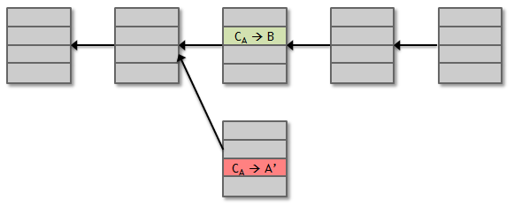
Recap
Protection against invalid transactions is cryptographic, but enforced by consensus
Protection against double-spending is purely by consensus
You’re never 100% sure a transaction is in consensus branch. Guarantee is probabilistic

Slide 31
Incentives and proof of work

Slide 32
Assumption of honesty is problematic
Can we give nodes incentives for behaving honestly?
Everything so far is just a distributed consensus protocol
But now we utilize the fact that the currency has value
Can we reward nodes that created these blocks?
Can we penalize the node that created this block?

Slide 33
Incentive 1: Block Reward
Creator of block gets to
include special coin-creation transaction in the block
choose recipient address of this transaction
Value is fixed: currently 12.5 BTC, halves every 210,000 blocks created (or every 4 years at the current rate of block creation)
We are now in the third period – first period block reward was 50 BTC
Block creator gets to “collect” the reward only if the block ends up on long-term consensus branch!
Subtle but powerful trick: Incentivizes nodes to behave in way that will get other nodes to extend their block

Slide 34
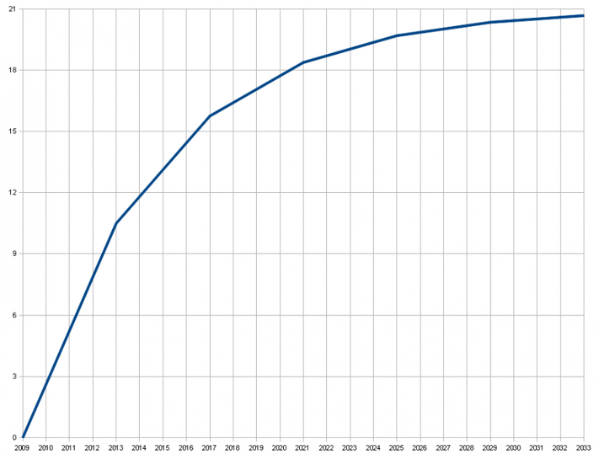
There’s a finite supply of bitcoins
Total supply: 21 million
Block reward is how new bitcoins are created
Runs out in 2040. No new bitcoins unless rules change
Does that mean that after 2040, nodes will no longer have incentive to behave honestly?
Not really!
Total bitcoins in circulation
First inflection point: reward halved from 50BTC to 25BTC
Year

Slide 35
Incentive 2: Transaction Fees
Creator of transaction can choose to make output value less than input value
Remainder is a transaction fee and goes to block creator (that first puts that transaction into that block)
Purely voluntary, like a tip
But system will evolve, and will become mandatory, as Block rewards run out

Slide 36
Remaining problems
How to pick a random node?
How to avoid a free-for-all due to rewards?
Everybody may want to run a bitcoin node in order to get this free reward (lock reward and Transaction fee)
How to prevent Sybil attacks?
An adversary may create a large number of Sybil nodes to subvert the consensus process

Slide 37
Proof of work
To approximate selecting a random node: select nodes in proportion to a resource that no one can monopolize (we hope)
In proportion to computing power: proof-of-work (Used in Bitcoins)
In proportion to ownership of the currency: proof-of-stake (Not used in Bitcoins – but a legitimate model used in other cryptocurrencies)

Slide 38
Equivalent views of proof of work
Select nodes in proportion to computing power
Let nodes compete for right to create block
Make it moderately hard to create new identities

Slide 39
Hash puzzles
nonce
To create block, find nonce s.t.
H(nonce ‖ prev_hash ‖ tx ‖ … ‖ tx) is very small
In other words, H(nonce ‖ prev_hash ‖ tx ‖ … ‖ tx) < target
prev_h
Tx
Tx
Output space of hash
Target
space
If hash function is secure (satisfies puzzle-friendliness):
only way to succeed is to try enough nonces until you get lucky
Notes:
If Alice has 100x more computing power than Bob it doesn’t mean she always wins the race. It means she has about a 99% chance of wining. In the long run Bob will create 1% of the blocks

Slide 40
Advantage of such a PoW system?
It completely does away with the problem of magically picking a random node (to propose a block)
Nodes independently compete by attempting to solve hash puzzles
Once in a while, one will succeed and propose the next block
Result: Such a system is completely decentralized → No one gets to decide which node proposes the next block

Slide 41
PoW property 1: difficult to compute
Difficulty varies with time
As of 2015: difficulty level is over 10²⁰ hashes/block
i.e., size of target space <= 1/10²⁰ size of hash’s output space
Such a computation not possible with commodity laptops
Only some nodes bother to compete — miners
This process of repeatedly solving hash puzzles is called bitcoin mining
Technically anyone can mine → however mining power is concentrated in a mining ecosystem

Slide 42
PoW property 2: parameterizable cost
Nodes automatically re-calculate the target (size of target space as a fraction of the output space) every two weeks
Goal: average time between blocks = 10 minutes
In other words, recalculation takes place after 2,016 blocks!
Prob (Alice wins next block) =
fraction of global hash power she controls
Notes:
what happens if time b/w blocks is too low or too high

Slide 43
Why is such a re-adjustment needed?
It is inefficient if blocks are proposed too close to each other
Would not be able to put multiple transactions in a single block!
Why 10 minutes?
Not significant!
Can change it to 5 minutes, and system would still work

Slide 44
Key security assumption
Bitcoin attacks infeasible if majority of miners weighted by hash power follow the protocol (or are honest)
This will ensure a more than 50% chance that the next block is proposed by a honest node!

Slide 45
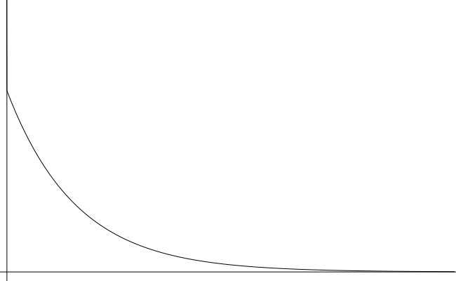
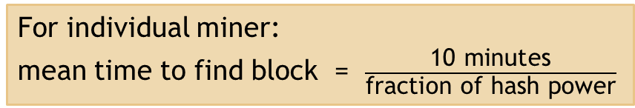
Solving hash puzzles is probabilistic
10
minutes
Probability density
Time to next block (entire network)

Slide 46
PoW property 3: trivial to verify
Nonce must be published as part of block
Other miners simply verify that
H(nonce ‖ prev_hash ‖ tx ‖ … ‖ tx) < target
Advantage?
No centralized verifier needed! Any node or miner can verify that the block was correctly mined

Slide 47
Mining economics
Complications:
Fixed (hardware) vs. variable (electricity) costs
Reward depends on rate at which miners propose blocks (ratio of their hash rate to the global hash rate)
Cost in dollars, but reward in BTC → profit depends on exchange rate
Solving more than 10²⁰ hashes to obtain 12.5 BTC at current exchange rate is profitable!
If mining reward (block reward + Tx fees) | > | mining cost (hardware + electricity cost) | → | Profit

Slide 48
Putting it all together

Slide 49
Recap
Identities
Transactions
P2P network
Block chain & consensus
Hash puzzles & mining

Slide 50
Bitcoin has three types of consensus
Value
State
Rules

Slide 51
Bitcoin is bootstrapped
security of block chain
health of mining ecosystem
value of currency

Slide 52
What can a “51% attacker” do?
Steal coins from existing address?
Suppress some transactions?
From the block chain
From the P2P network
Change the block reward?
Destroy confidence in Bitcoin?
✗
✓
✗
✗
✓✓

Slide 53
Remaining questions
How do we get from consensus to currency?
What else can we do with consensus?

